Slide 1

Amplification of data through the use of super resolution based on generative adversarial network(GAN)
MS COMPUTER SCIENCE
Sania Rehmat
Sir Rao Sohail Iqbal
Session 2018-2020
Department:Computer Science
2019

Slide 2


SANIA REHMAT
Sania11.lcwu@gmail.com

Slide 3
TABLE OF CONTENTS
Introduction
Problem Background
Problem Statement
Research Questions
Research Objectives
Aim and Scope of Research
Literature review
Methodology
Reference
SANIA REHMAT
Sania11.lcwu@gmail.com

Slide 4

1. INTRODUCTION
SANIA REHMAT
Sania11.lcwu@gmail.com

Slide 5
INTRODUCTION
Amplification of data through the use of super resolution based on generative adversarial network(GAN)
Artifical intelligence:Artifical intelligence (AI)is the simulation of human intelligence by machines.
The ability to solve problem
The ability to act rationally
The ability to act like human
SANIA REHMAT
Sania11.lcwu@gmail.com
Notes:
Write your notes here.
Write here what you will speak during the presentation

Slide 6
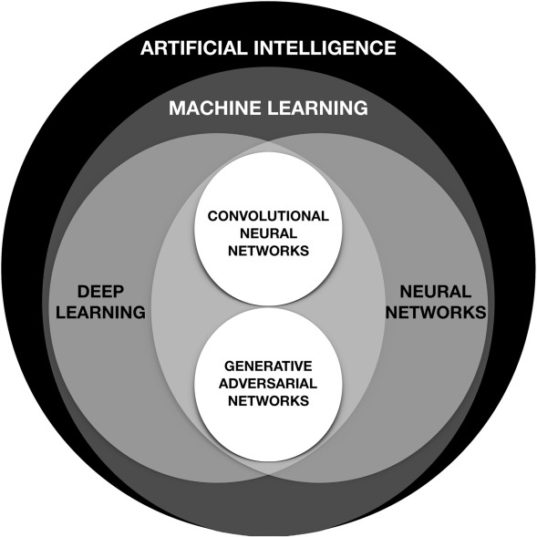
INTRODUCTION
Amplification of data through the use of super resolution based on generative adversarial network(GAN)
Sub Domain of Artifical intelligence(AI)
Figure1. Artifical Intelligence
SANIA REHMAT
Sania11.lcwu@gmail.com
Notes:
Write your notes here.
Write here what you will speak during the presentation

Slide 7
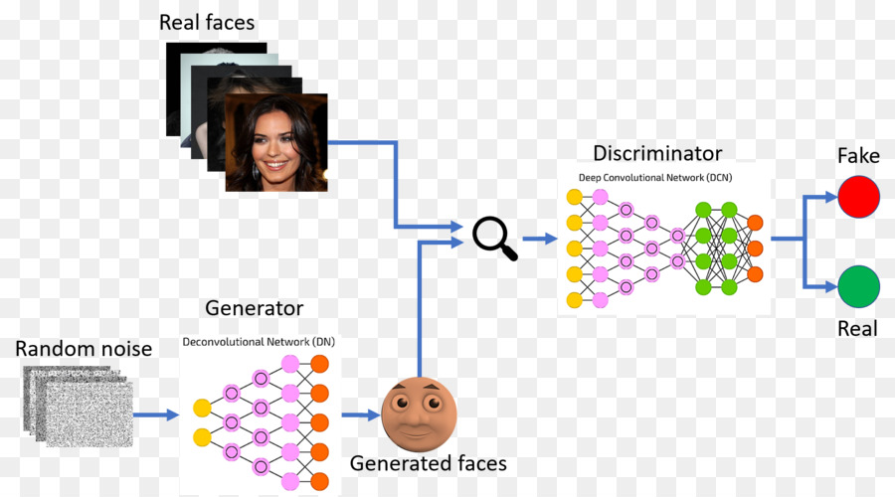
INTRODUCTION
Amplification of data through the use of super resolution based on generative adversarial network(GAN)
A generative adversarial network (GAN) is a class of machine learning(unsupervised learning) systems invented by Ian Goodfellow and his colleagues in 2014.
Super Resolution (SR) mean to approximate and improve the resultant high resolution graphical output from a particular low resolution graphical input.
Super resolution generative adversarial network depend upon generative adversarial network(GAN) which consist of two network such as generative network (GN) and discriminative network (DN).
Figure 2.GAN Architecture
SANIA REHMAT
Sania11.lcwu@gmail.com
1 of 15
Notes:
Write your notes here.
Write here what you will speak during the presentation

Slide 8
2. PROBLEM BACKGROUND
SANIA REHMAT
Sania11.lcwu@gmail.com

Slide 9
PROBLEM BACKGROUND
Problem | Reference
HR image require more processing and memory to train CNN but current modles does not have the same feature | Shorten, C., & Khoshgoftaar, T. M. (2019). A survey on image data augmentation for deep learning. Journal of Big Data, 6(1), 60.
Low quality of GAN sample and testing their effectiveness on wide range of dataset | Shorten, C., & Khoshgoftaar, T. M. (2019). A survey on image data augmentation for deep learning. Journal of Big Data, 6(1), 60.
Achieving high resolution from GAN sample is difficut | Shorten, C., & Khoshgoftaar, T. M. (2019). A survey on image data augmentation for deep learning. Journal of Big Data, 6(1), 60.
9
SANIA REHMAT
Sania11.lcwu@gmail.com
Notes:
Write your notes here.
Write here what you will speak during the presentation

Slide 10
PROBLEM BACKGROUND
Problem | Reference
HR image require more processing and memory to train CNN but current modles does not have the same feature | Shorten, C., & Khoshgoftaar, T. M. (2019). A survey on image data augmentation for deep learning. Journal of Big Data, 6(1), 60.
Low quality of GAN sample and testing their effectiveness on wide range of dataset | Shorten, C., & Khoshgoftaar, T. M. (2019). A survey on image data augmentation for deep learning. Journal of Big Data, 6(1), 60.
Achieving high resolution from GAN sample is difficult | Shorten, C., & Khoshgoftaar, T. M. (2019). A survey on image data augmentation for deep learning. Journal of Big Data, 6(1), 60.
10
SANIA REHMAT
Sania11.lcwu@gmail.com
Notes:
Write your notes here.
Write here what you will speak during the presentation

Slide 11
3. PROBLEM STATEMENT
SANIA REHMAT
Sania11.lcwu@gmail.com

Slide 12
PROBLEM STATEMENT
Amplification of data through the use of super resolution based on generative adversarial network(GAN)
Producing high resolution outputs from GAN sample is very difficult due to issues with training stability and mode collapse. The use of super-resolution networks such as SRGAN could be an effective technique for improving the quality of outputs from a DCGAN sample and compare the results with progressively growing GAN model.
SANIA REHMAT
Sania11.lcwu@gmail.com
Notes:
Write your notes here.
Write here what you will speak during the presentation

Slide 13
4. RESEARCH QUESTIONS
SANIA REHMAT
Sania11.lcwu@gmail.com

Slide 14
RESEARCH QUESTIONS
Amplification of data through the use of super resolution based on generative adversarial network(GAN)
how can we achieve high resolution from this research paper?
SANIA REHMAT
Sania11.lcwu@gmail.com
Notes:
Write your notes here.
Write here what you will speak during the presentation

Slide 15
5. RESEARCH OBJECTIVES
SANIA REHMAT
Sania11.lcwu@gmail.com

Slide 16
RESEARCH OBJECTIVES
Amplification of data through the use of super resolution based on generative adversarial network(GAN)
To generate high resolution output from DCGAN sample
To compare the performane of both SRGAN and PGGAN architecture
To resolve training stability and mode collapse issue
SANIA REHMAT
Sania11.lcwu@gmail.com
Notes:
Write your notes here.
Write here what you will speak during the presentation

Slide 17
6. AIM & SCOPE OF RESEARCH
SANIA REHMAT
Sania11.lcwu@gmail.com

Slide 18
AIM & SCOPE OF RESEARCH
Amplification of data through the use of super resolution based on generative adversarial network(GAN)
AIMS :
Achieving High resolution output more than GAN sample
Improve training insatability issue
Improve non-convergence issue
SCOPE :
use Machine lerarning algorithms like SRGAN,DCGAN and PGGAN etc.
SANIA REHMAT
Sania11.lcwu@gmail.com
Notes:
Write your notes here.
Write here what you will speak during the presentation

Slide 19
7. LITERATURE REVIEW
SANIA REHMAT
Sania11.lcwu@gmail.com

Slide 20
LITERATURE REVIEW
Amplification of data through the use of super resolution based on generative adversarial network(GAN)
The GAN architecture first proposed by Ian Goodfellow [10] is a framework for generative modeling through adversarial training.
There have been many new architectures which improve the quality of GAN sample includes DCGAN,progressively growing GAN,cyclic GAN etc.
The idea behind DCGAN[2] is to increase the complexity of the generator network to project the input into a high dimensional tensor and then add deconvolutional layers to go from the projected tensor to an output image. These deconvolutional layers will expand on the spatial dimensions, for example, going from 14 × 14 × 6 to 28 × 28 × 1, whereas a convolutional layer will decrease the spatial dimensions such as going from 14 × 14 × 32 to 7 × 7 × 64. The DCGAN architecture presents a strategy for using convolutional layers in the GAN framework to produce higher resolution images .
SANIA REHMAT
Sania11.lcwu@gmail.com
Notes:
Write your notes here.
Write here what you will speak during the presentation

Slide 21
LITERATURE REVIEW
Amplification of data through the use of super resolution based on generative adversarial network(GAN)
Progressively Growing GANs 2017 [20] trains a series of networks with progressive resolution complexity. These resolutions range from 4 × 4 to 8 × 8 and so on until outputs of size 1024 × 1024 are achieved. This is built on the concept that GANs can accept images as input as well as random vectors. Therefore, the series of GANs work by passing samples from a lower resolution GAN up to higher-resolution GANs. This has produced very amazing results on facial images.
As exciting as the potential of GANs is, it is very difficult to get high-resolution outputs from the current cutting-edge architectures. Increasing the output size of the images produced by the generator will likely cause training instability and non-convergence. Another drawback of GANs is that they require a substantial amount of data to train. Thus, depending on how limited the initial dataset is, GANs may not be a practical solution. Salimans et al. [18] provide a more complete description of the problems with training GANs.
SANIA REHMAT
Sania11.lcwu@gmail.com
Notes:
Write your notes here.
Write here what you will speak during the presentation

Slide 22
8. METHODOLOGY
SANIA REHMAT
Sania11.lcwu@gmail.com

Slide 23
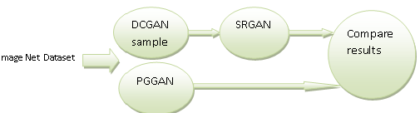
METHODOLOGY
Amplification of data through the use of super resolution based on generative adversarial network(GAN)
Imagenet dataset is used in this research paper
Progressively Growing GAN apply on the above mentioned dataset
By using same dataset Deep convolutional generative adversarial network (DCGAN) sample is inserted into the super resolution generative adversarial network (SRGAN).
Finally compare the performance of both networks and then notify which network show high resolution than GAN sample
MATLAB is used for testing purpose
Figure 3. Performance diagram of SRGAN with progressively growing GAN
SANIA REHMAT
Sania11.lcwu@gmail.com
Notes:
Write your notes here.
Write here what you will speak during the presentation

Slide 24
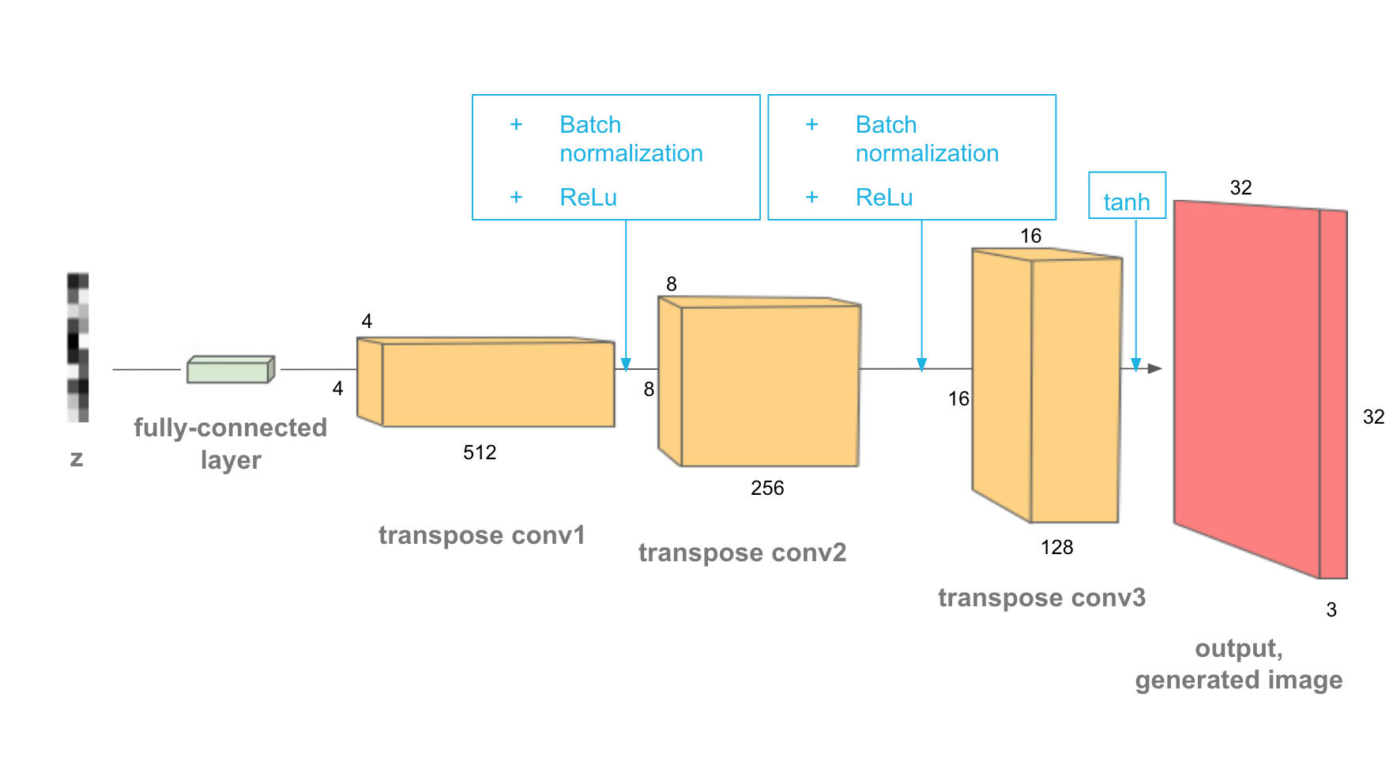
DCGAN WORKING
Amplification of data through the use of super resolution based on generative adversarial network(GAN)
Figure 4.Generator
SANIA REHMAT
Sania11.lcwu@gmail.com
Notes:
Write your notes here.
Write here what you will speak during the presentation

Slide 25
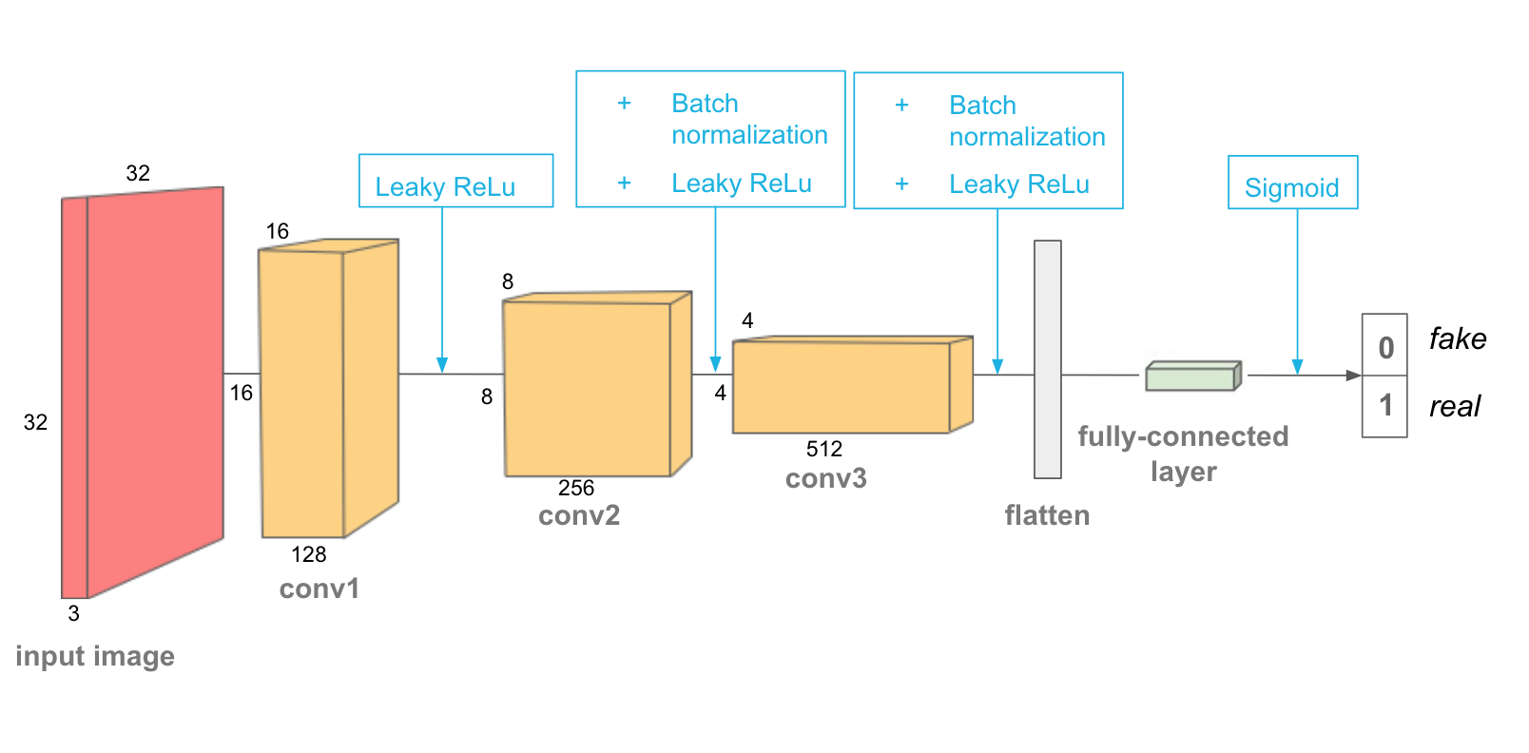
DCGAN WORKING
Amplification of data through the use of super resolution based on generative adversarial network(GAN)
Figure 5. Discriminator
SANIA REHMAT
Sania11.lcwu@gmail.com
Notes:
Write your notes here.
Write here what you will speak during the presentation

Slide 26
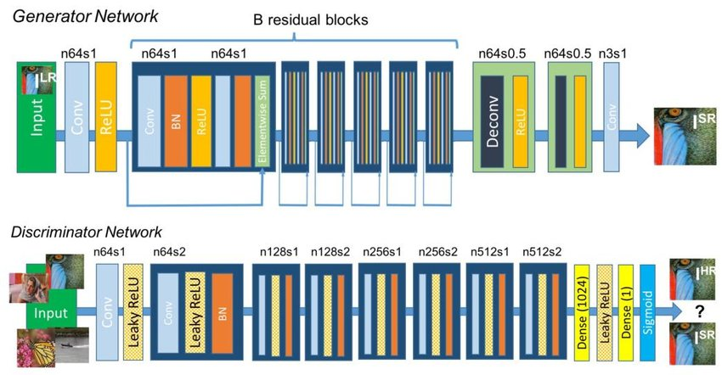
SRGAN WORKING
Amplification of data through the use of super resolution based on generative adversarial network(GAN)
SANIA REHMAT
Sania11.lcwu@gmail.com
Notes:
Write your notes here.
Write here what you will speak during the presentation

Slide 27
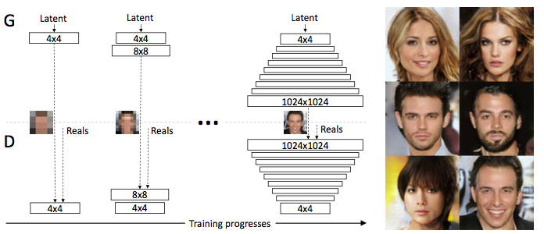
PROGRASSIVELY GROWING GAN(PGGAN) WORKING
Amplification of data through the use of super resolution based on generative adversarial network(GAN)
SANIA REHMAT
Sania11.lcwu@gmail.com
Notes:
Write your notes here.
Write here what you will speak during the presentation

Slide 28
9.REFERENCES
SANIA REHMAT
Sania11.lcwu@gmail.com

Slide 29
REFERENCES
Amplification of data through the use of super resolution based on generative adversarial network(GAN)
[1].Ahirwal, B., Khadtare, M., & Mehta, R. (2007, November). FPGA based system for color space transformation RGB to YIQ and YCbCr. In 2007 International Conference on Intelligent and Advanced Systems (pp. 1345-1349). IEEE.
[2]. Alec R, Luke M, Soumith C. Unsupervised representation learning with deep convolutional generative adversarial networks. ICLR, 2016.
[3].Antoniou, A., Storkey, A., & Edwards, H. (2017). Data augmentation generative adversarial networks. arXiv preprint arXiv:1711.04340.
[4].Arjovsky, M., Chintala, S., & Bottou, L. (2017). Wasserstein gan. arXiv preprint arXiv:1701.07875.
[5].Braun, S., Neil, D., & Liu, S. C. (2017, August). A curriculum learning method for improved noise robustness in automatic speech recognition. In 2017 25th European Signal Processing Conference (EUSIPCO) (pp. 548-552). IEEE.
[6].Brock, A., Donahue, J., & Simonyan, K. (2018). Large scale gan training for high fidelity natural image synthesis. arXiv preprint arXiv:1809.11096.
SANIA REHMAT
Sania11.lcwu@gmail.com
Notes:
Write your notes here.
Write here what you will speak during the presentation

Slide 30
REFERENCES
Amplification of data through the use of super resolution based on generative adversarial network(GAN)
[7].Chen, B. X., Liu, T. J., Liu, K. H., Liu, H. H., & Pei, S. C. (2019, September). Image Super-Resolution Using Complex Dense Block on Generative Adversarial Networks. In 2019 IEEE International Conference on Image Processing (ICIP) (pp. 2866-2870). IEEE.
[8].Frid-Adar, M., Klang, E., Amitai, M., Goldberger, J., & Greenspan, H. (2018). Gan-based data augmentation for improved liver lesion classification.
[9].Gu, J., Li, Z., Wang, Y., Yang, H., Qiao, Z., & Yu, J. (2019). Deep Generative Adversarial Networks for Thinsection Infant MR Image Reconstruction. IEEE Access.
[10].I. J. Goodfellow, J. Pouget-Abadie, M. Mirza, B. Xu, D. Warde-Farley, S. Ozair, A. Courville, and Y. Bengio, "Generative adversarial nets," in Advances in Neural Information Processing Systems, 2014, pp. 26722680.
[11].Koistinen, P., & Holmström, L. (1992). Kernel regression and backpropagation training with noise. In Advances in Neural Information Processing Systems (pp. 1033-1039).
[12].Ledig, C., Theis, L., Huszár, F., Caballero, J., Cunningham, A., Acosta, A., ... & Shi, W. (2017). Photo-realistic single image super-resolution using a generative adversarial network. In Proceedings of the IEEE conference on computer vision and pattern recognition (pp. 4681-4690).
SANIA REHMAT
Sania11.lcwu@gmail.com
Notes:
Write your notes here.
Write here what you will speak during the presentation

Slide 31
REFERENCES
Amplification of data through the use of super resolution based on generative adversarial network(GAN)
[13].Mikołajczyk, A., & Grochowski, M. (2018, May). Data augmentation for improving deep learning in image classification problem. In 2018 international interdisciplinary PhD workshop (IIPhDW) (pp. 117-122). IEEE.
[14].Radford, A., Metz, L., & Chintala, S. (2015). Unsupervised representation learning with deep convolutional generative adversarial networks. arXiv preprint arXiv:1511.06434.
[15].Sharma, A., Jindal, N., & Thakur, A. (2018, December). Comparison on Generative Adversarial Networks–A Study. In 2018 First International Conference on Secure Cyber Computing and Communication (ICSCCC) (pp. 391-396). IEEE.
[16].Shorten, C., & Khoshgoftaar, T. M. (2019). A survey on image data augmentation for deep learning. Journal of Big Data, 6(1), 60.
[17].Tran, K., Panahi, A., Adiga, A., Sakla, W., & Krim, H. (2019, May). Nonlinear Multi-scale Super-resolution Using Deep Learning. In ICASSP 2019-2019 IEEE International Conference on Acoustics, Speech and Signal Processing (ICASSP) (pp. 3182-3186). IEEE.
[18]. Tim S, Ian G, Wojciech Z, Vicki C, Alec R, Xi C. Improved techniques for training GANs. arXiv preprint. 2016.
[19].Wang, Z., Ye, M., Yang, F., Bai, X., & Shin'ichi Satoh. (2018, July). Cascaded SR-GAN for Scale-Adaptive Low Resolution Person Re-identification. In IJCAI (pp. 3891-3897).
[20]. Tero K, Timo A, Samuli L, Jaakko L. Progressive growing of GANs for improved quality, stability, and variation. CoRR, abs/1710.10196, 2017.
SANIA REHMAT
Sania11.lcwu@gmail.com
Notes:
Write your notes here.
Write here what you will speak during the presentation

Slide 32

THANK YOU
SANIA REHMAT
Sania11.lcwu@gmail.com

